Slide 1
CUSTOMER RETENTION
By
Arti Sharma

Slide 2
Introduction
Customer retention refers to a company’s ability to turn customers into repeat buyers and prevent them from switching to a competitor.
Acquiring a new customer can be 5 to 25 times more expensive than holding on to an existing one.
Businesses work hard to attract customers through a mix of marketing, social media, and brand strategies.
The customer experience involves everything customers think and feel when they encounter any brand.
You’ve invested a lot of time and effort (and probably money) gaining your customers’ trust. It only makes sense when you want to hold on to them.

Slide 3
Key Points
Gender of Respondent
Age
Major orders placed from cities
Duration
Mode of Access
Customer’s Feedback
Conclusion

Slide 4
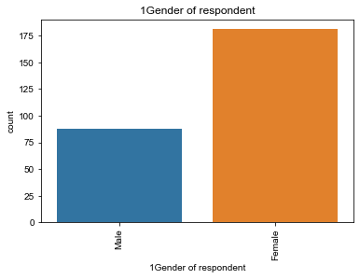
Gender of Respondent
Female respondent are more than male.
Men’s motives for shopping appear to be more utilitarian, whereas women’s shopping motives tend to be hedonic.
That means men shopping to get something done.
Whereas women shop because they love it.
Women are quick to decide anything whereas men quantify every aspect before purchase.

Slide 5
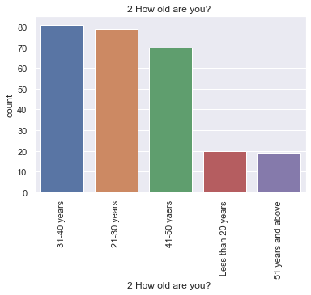
Age Impact
Age impacts the buying behaviour.
Age brings changes to people's lifestyle and affects their needs and personal values.
As the visual reflects that age group of 21 to 40 years are more active on buying things online.
When people are young, they spend more on their lifestyle needs like fun, movies and fashion.

Slide 6
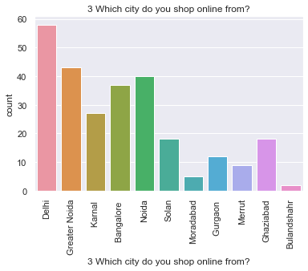
Major orders placed from cities
As shown in the figure Delhi tops the list of highest number of order placed followed by Greater Noida , Noida, Bangalore ,Ghaziabad and so on.
People from metro cities are more actively shop online.

Slide 7
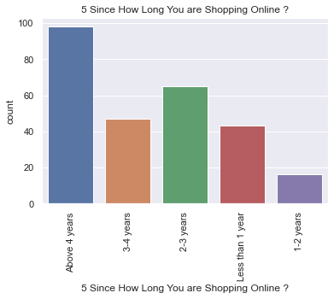
Duration
Customers have spend more than 4 years in shopping from online retail stores.
It means customers trust the online stores and satisfied by the services they have been provided.
So after analyzing this figure can say that retaining customers could be easier if they are adequately served.

Slide 8
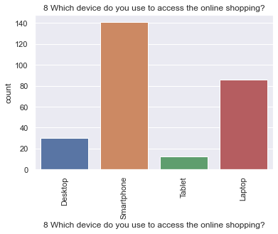
Mode of Access
Preferred mode of shopping is smartphone.
Because its handy.
Majority of people have smartphones now a days.
Application can be easily access through smartphones.
Shop through laptop is the 2nd priority.

Slide 9
Customer’s Feedback
Customer retention is essential part of any business.
There are a lot of other factors that can help in retaining customers.
Some of them is there feedback either it is negative or positive.
Negative feedback motivates to work on the flaws and on the other hand positive feedback also encourages to put more efforts for the customers satisfaction.
Feedback let the company know how the customer perceives there service.
While giving feedback customer wants to convey their thoughts as if where they are looking for the company's support whether it is their privacy , product issue etc.
Customers expect from the company is to deliver the product on time , their financial privacy , variety of products, availability of multiple online payment options and trustworthiness.

Slide 10
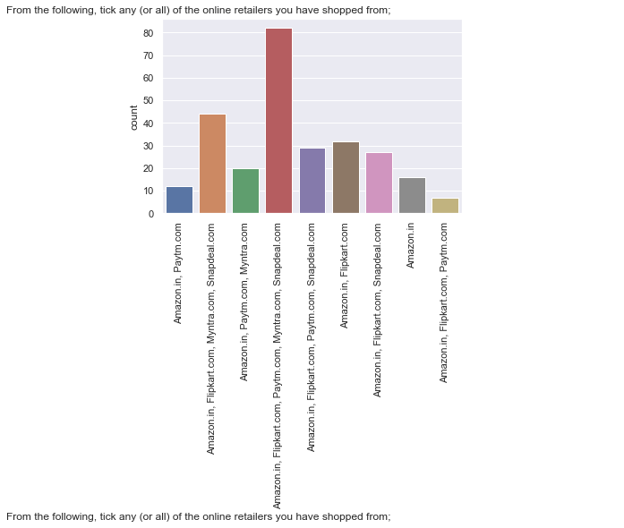
Conclusion
After analyzing the dataset it comes into picture that AMAZON is the top online retails store followed by FLIPKART,PAYTM and MYNTRA and SNAPDEAL,
Amazon is the most trusted , reliable, having good layout ,having wast variety of products, easy to use ,faster delivery, multiple mode of payment makes it most popular among other retail stores.
As more people will satisfied with the online retails stores will more likely to recommend their friends and relatives too.

Slide 11
THANKS :)

